Slide 1

CLASS 10 · MATHEMATICS
Arithmetic
Progressions
Rest of the chapter: sum of n terms
One term → total of many terms
A pattern becomes powerful when it can calculate totals without writing every term.
Arithmetic Progressions · Sum of n terms
1
Notes:
Opening line: We already know how to reach one term using a_n = a + (n−1)d. Today the question changes: what if we need the total?
Keep the language student-facing: one term vs many terms.

Slide 2
Today’s learning route
A fast recap, then a powerful formula and selected high-value problems
1
2
3
4
5
Connect nth term to total
Discover Gauss pairing
Choose the right formula
Solve best chapter problems
Quick assessment
One term tells a position; sum collects many positions.
Reverse the AP to make equal pairs.
Use a, d, n or use first + last.
Penalty, prizes, trees, spiral, logs and potato race.
Mixed questions to check understanding.
Goal: calculate totals without listing every term
Arithmetic Progressions · Sum of n terms
2
Notes:
Spend less than one minute. Tell the class exactly where the lesson is going.

Slide 3

From one term to many terms
Same AP, different question
12, 15, 18, 21, ...
Find 20th term
Find total in 20 terms
a₂₀ = one position
S₂₀ = total of positions 1–20
Term = one step
Sum = whole staircase
Arithmetic Progressions · Sum of n terms
3
Notes:
Say: nth term gives one position. Sum gives the total of many positions. Keep this contrast in their head.

Slide 4
Can we total faster?
A problem that looks long but has a pattern
1 + 2 + 3 + ... + 98 + 99 + 100
Writing and adding all 100 numbers works — but it is not elegant.
Hidden idea: pair the beginning with the end.
1 + 100 = 101 · 2 + 99 = 101 · 3 + 98 = 101
Arithmetic Progressions · Sum of n terms
4
Notes:
Before showing formula, pause and let them notice pairs. Then reveal the reverse trick.

Slide 5
Gauss pairing: reverse the list
Adding the same list from both ends creates equal pairs
S = 1 + 2 + 3 + ... + 98 + 99 + 100
S = 100 + 99 + 98 + ... + 3 + 2 + 1
2S = 101 + 101 + ... + 101
100 equal pairs
each pair = 101
divide by 2
S = 100 × 101 / 2 = 5050
Arithmetic Progressions · Sum of n terms
5
Notes:
Use this as the emotional hook. Tell them: The whole AP sum formula is this same trick.

Slide 6
Deriving Sₙ for any AP
The same reverse trick works for every fixed-jump pattern
Sₙ = a + (a+d) + (a+2d) + ... + l
Sₙ = l + (l−d) + (l−2d) + ... + a
2Sₙ = (a+l) + (a+l) + ... + (a+l)
n equal pairs
each pair = a + l
divide by 2
Sₙ = n/2 (a + l)
Arithmetic Progressions · Sum of n terms
6
Notes:
Say: +d and −d cancel, +2d and −2d cancel. Every pair becomes a+l. There are n such pairs in 2S_n.

Slide 7
Two forms of the same formula
Choose the form that matches what is given
Sₙ = n/2 (a + l)
Sₙ = n/2 [2a + (n−1)d]
Use when first term and last term are known.
Use when first term, common difference and n are known.
Because l = a + (n−1)d
One idea, two doors.
Arithmetic Progressions · Sum of n terms
7
Notes:
Important line: Do not force one formula everywhere. Choose the formula from the data.

Slide 8
Guided example: first 22 terms
Find the sum of the first 22 terms of 8, 3, −2, ...
Given AP
8, 3, −2, ...
a = 8
d = −5
n = 22
S₂₂ = 22/2 [2(8) + 21(−5)]
= 11 [16 − 105] = 11(−89)
S₂₂ = −979
Arithmetic Progressions · Sum of n terms
8
Notes:
This is a direct formula example. Mention negative sum is possible because later terms become negative.

Slide 9
Try it: 90-second challenge
Find the sum without writing all terms
2, 7, 12, ... to 10 terms
a = ?
d = ?
n = ?
Sₙ = ?
Work space
Arithmetic Progressions · Sum of n terms
9
Notes:
Answer: a=2, d=5, n=10, S=245. Give them time, then ask for a/d/n first before answer.

Slide 10
Solution: 2, 7, 12, ... to 10 terms
The formula becomes easy after a, d and n are identified
a = 2
d = 5
n = 10
S₁₀ = 10/2 [2(2) + 9(5)]
= 5[4 + 45] = 5 × 49
S₁₀ = 245
Check: the answer should be much bigger than the 10th term, because it is a total.
Arithmetic Progressions · Sum of n terms
10
Notes:
Good teacher line: Always do a rough sense check. Sum of 10 positive terms should be more than any single term.

Slide 11
Formula choice mini-drill
Do not solve yet: only choose the best formula
17, 26, 35, ... , 350
first + last given
Sₙ = n/2(a+l)
a = 5, d = 3, n = 10
a, d, n given
Sₙ = n/2[2a+(n−1)d]
first prize ₹160, last prize ₹40, 7 prizes
first + last known
Sₙ = n/2(a+l)
24, 21, 18, ... sum = 78
S is given; n unknown
solve equation in n
Arithmetic Progressions · Sum of n terms
11
Notes:
Quick oral check. This trains strategy, not calculation.

Slide 12
Story problem: money box
₹100 on first birthday, then ₹50 more each year, till 21st birthday
100, 150, 200, 250, ...
a = 100
d = 50
n = 21
S₂₁ = 21/2 [2(100) + 20(50)]
S₂₁ = ₹12,600
Arithmetic Progressions · Sum of n terms
12
Notes:
This is from the NCERT chapter opening. Use it to show that sum answers total savings, not one birthday amount.

Slide 13

Challenge problem: delay penalty
A real-world AP where the total matters
Penalty: ₹200 on day 1, ₹250 on day 2, ₹300 on day 3, ...
The penalty increases by ₹50 every day.
Total penalty for 30 days?
Thinking space
Arithmetic Progressions · Sum of n terms
13
Notes:
Let them translate the story into AP: 200, 250, 300, ... up to 30 terms.

Slide 14
Solution: delay penalty
Translate the story into an AP before applying formula
200, 250, 300, ...
a = 200
d = 50
n = 30
S₃₀ = 30/2 [2(200) + 29(50)]
= 15[400 + 1450] = 15 × 1850
Total penalty = ₹27,750
Arithmetic Progressions · Sum of n terms
14
Notes:
This is one of the best NCERT real-life AP sum problems. The hook is that total penalty grows faster than students expect.

Slide 15
Best problem: seven cash prizes
Total ₹700, each prize ₹20 less than the previous prize
Prize pattern
a, a−20, a−40, a−60, a−80, a−100, a−120
700 = 7/2 [2a + 6(−20)]
700 = 7/2 (2a − 120) → 200 = 2a − 120 → a = 160
₹160, ₹140, ₹120, ₹100, ₹80, ₹60, ₹40
Arithmetic Progressions · Sum of n terms
15
Notes:
Emphasize that first prize is unknown. We write the AP in terms of a and use the sum to determine a.

Slide 16

Best problem: tree plantation
Three sections of each class I to XII plant trees equal to their class number
One section plants:
1 + 2 + 3 + ... + 12
S₁₂ = 12/2 (1 + 12) = 78
Total = 3 × 78 = 234 trees
Arithmetic Progressions · Sum of n terms
16
Notes:
A strong value-based problem. Say: mathematical patterns can model social action too.

Slide 17
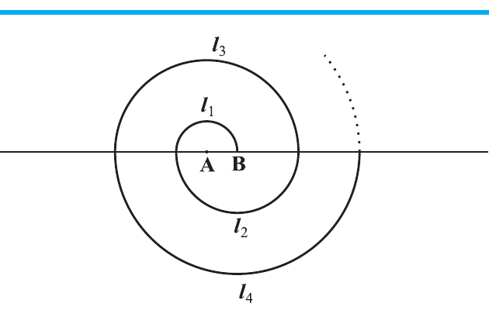
Visual problem: spiral of semicircles
Thirteen semicircles with radii 0.5, 1.0, 1.5, 2.0, ... cm
Length of one semicircle = πr
So total length = π × sum of radii
Radii AP: 0.5, 1.0, 1.5, ... to 13 terms
Work space
Arithmetic Progressions · Sum of n terms
17
Notes:
Let the class discover that the AP is in radii, and semicircle length is πr.

Slide 18
Solution: spiral of semicircles
Convert geometry into AP sum
a = 0.5
d = 0.5
n = 13
Sum of radii = 13/2 (0.5 + 6.5)
= 13/2 × 7 = 45.5 cm
Total length = π × 45.5 = 143 cm
Arithmetic Progressions · Sum of n terms
18
Notes:
Use π = 22/7. 45.5 = 91/2, so (22/7)*(91/2)=143.

Slide 19

Visual problem: stacked logs
20 logs in bottom row, 19 in next, 18 in next ... total 200 logs
Pattern: 20 + 19 + 18 + ... = 200
Find: number of rows and logs in the top row
Work space
Arithmetic Progressions · Sum of n terms
19
Notes:
Pause before solution. This is a quadratic from sum formula; guide them slowly.

Slide 20
Solution: stacked logs
A decreasing AP where n is unknown
a = 20
d = −1
Sₙ = 200
200 = n/2 [40 + (n−1)(−1)]
400 = n(41 − n) → n² − 41n + 400 = 0
(n − 16)(n − 25) = 0
n = 25 gives top row negative, so reject.
16 rows; top row = 5 logs
Arithmetic Progressions · Sum of n terms
20
Notes:
Emphasize validity: not every algebraic root makes sense in the real situation.

Slide 21
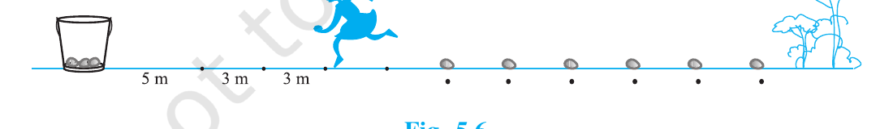
Race problem: potato collection
Bucket is 5 m from first potato; potatoes are 3 m apart; 10 potatoes total
First potato round trip = 2 × 5 = 10 m
Second potato round trip = 2 × 8 = 16 m
Distance pattern: 10, 16, 22, ...
Find total distance for 10 potatoes
Arithmetic Progressions · Sum of n terms
21
Notes:
Make them see why the jump is 6: every next potato is 3 m farther, and the runner goes out and back, so +6 m.

Slide 22
Solution: potato race
Each next potato adds 6 metres to the round trip
a = 10
d = 6
n = 10
S₁₀ = 10/2 [2(10) + 9(6)]
= 5[20 + 54] = 5 × 74
Total distance = 370 m
Key insight: +3 m farther one way becomes +6 m for a round trip.
Arithmetic Progressions · Sum of n terms
22
Notes:
This is one of the most memorable chapter problems. It converts a race into an AP.

Slide 23
Advanced connection: Sₙ can reveal aₙ
The nth term is the new amount added when we go from Sₙ₋₁ to Sₙ
aₙ = Sₙ − Sₙ₋₁
Example: Sₙ = 4n − n²
S₁ = 3
S₂ = 4
a₂ = S₂ − S₁ = 1
a₃ = S₃ − S₂ = −1
a₁₀ = S₁₀ − S₉ = −15
aₙ = 5 − 2n
Sum is cumulative. Term is the fresh addition.
Arithmetic Progressions · Sum of n terms
23
Notes:
Use only if the class is comfortable. This is a strong conceptual slide for Q11.

Slide 24
3-minute mixed check
Solve any two; explain the first step clearly
1
Find S₁₂ of 5, 9, 13, ...
2
How many terms of 9, 17, 25, ... give sum 636?
3
Find the sum of first 15 multiples of 8.
4
If Sₙ = 4n − n², find a₁₀.
Arithmetic Progressions · Sum of n terms
24
Notes:
Answers: 324; 12 terms; 960; -15. Use this for assessment if time remains.

Slide 25
Chapter map: AP in one page
Everything comes from the fixed-jump idea
AP: a, a+d, a+2d, ...
aₙ = a + (n−1)d
Sₙ = n/2(a + l)
Sₙ = n/2[2a + (n−1)d]
One term: locate a position.
Sum: collect many positions.
Real problems: identify first term, jump and count.
Fixed jump → formula → real-life total
Arithmetic Progressions · Sum of n terms
25
Notes:
Closing line: AP is not a formula chapter; it is a fixed-jump pattern chapter.

